Slide 1

Predicting Flight Delays
LHL- MIDTERM PROJECT
Vivien Ho, Vicki Chen & YuHeng Yang

Slide 2
PREDICTING FLIGHT DELAYS
OBJECTIVE:
Build a model that predicts flight delays in USA before they are announced.
FULL DATASET:
Flights: US flights in years 2018 and 2019
Fuel consumption: Different airlines from 2015 to 2019 aggregated per month
Passengers: Totals on different routes from years 2015 to 2019 aggregated per month
Flights test: Departure and arrival information about flights in US in Jan 2020

Slide 3

ARRIVAL DELAYS
Departure Delay
Carrier Delay
Weather Delay
National Aviation System (NAS) Delay
Security Delay
Late aircraft delay

Slide 4

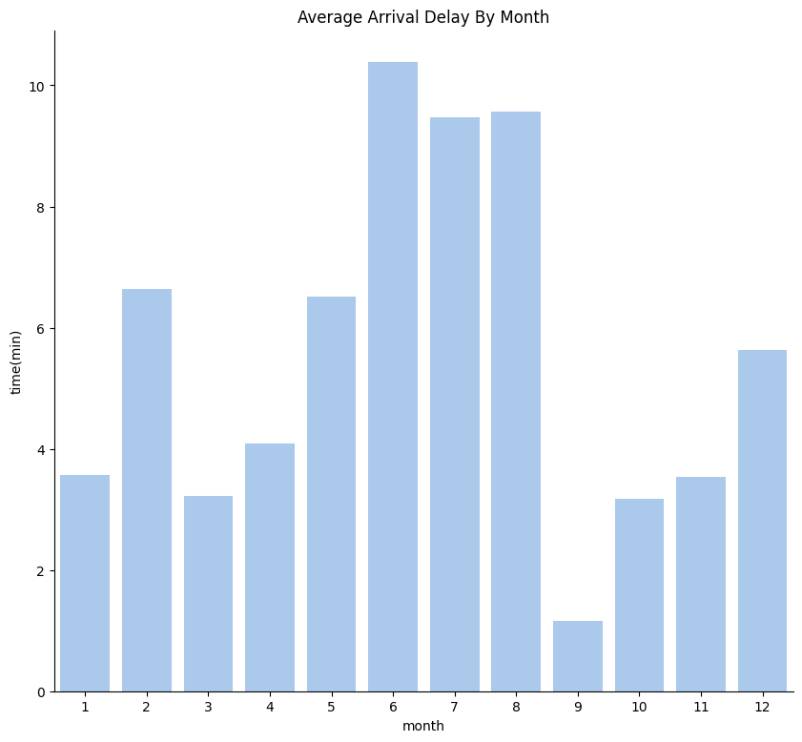
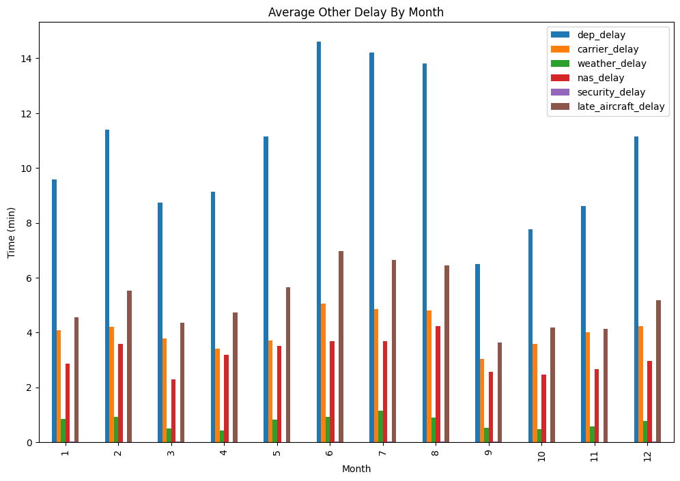
DELAY TYPE ANALYSIS
Notes:
Month June, July and Aug have the highest number of delays.
Departure delay and late aircraft delays are the main two factors causes.

Slide 5
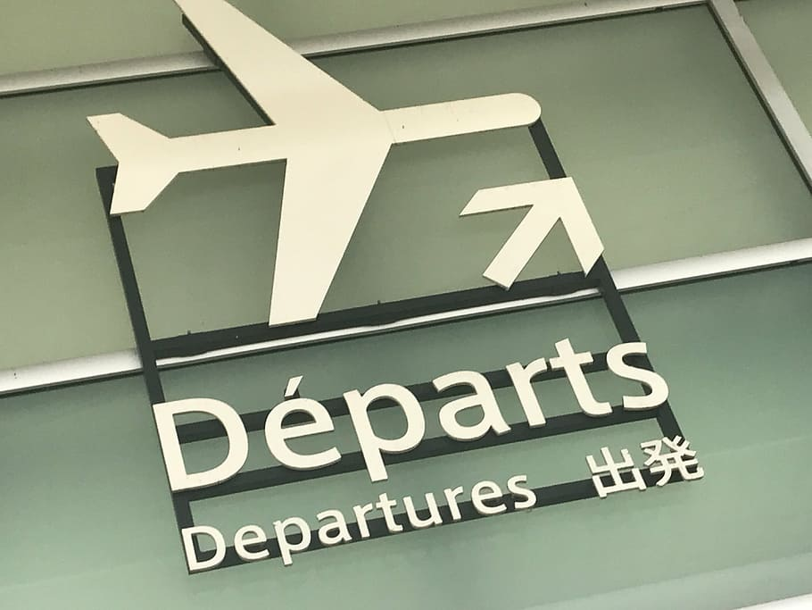
74%
Of delays created before departure
T test if planes fly faster when there is departure delay:
P-Value: 1.4757 > 0.5 , YES!

Slide 6


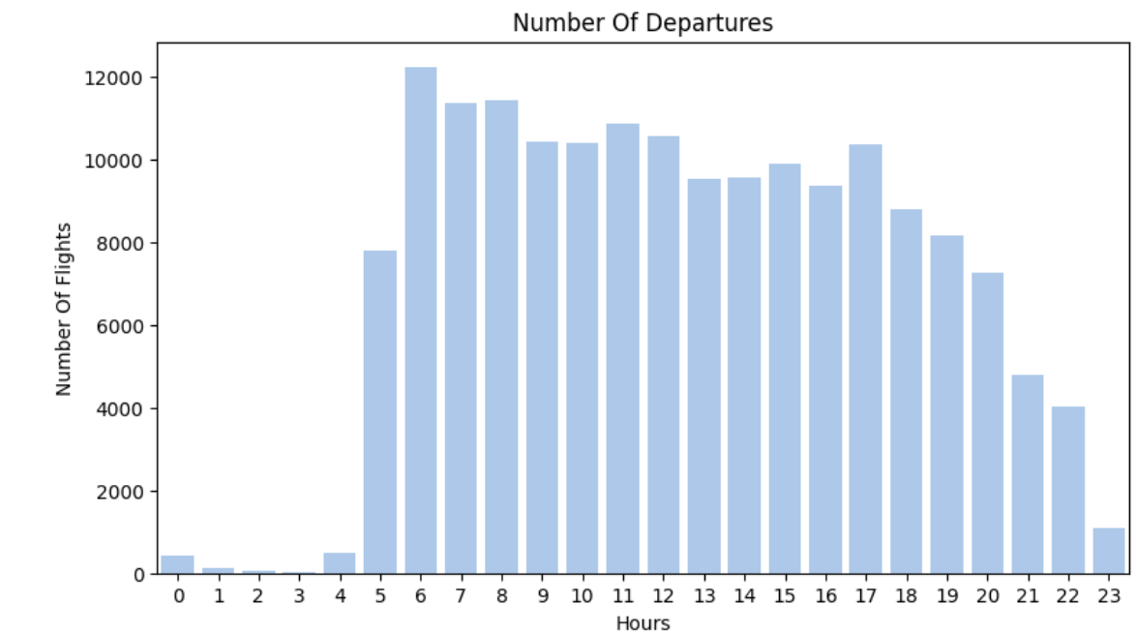
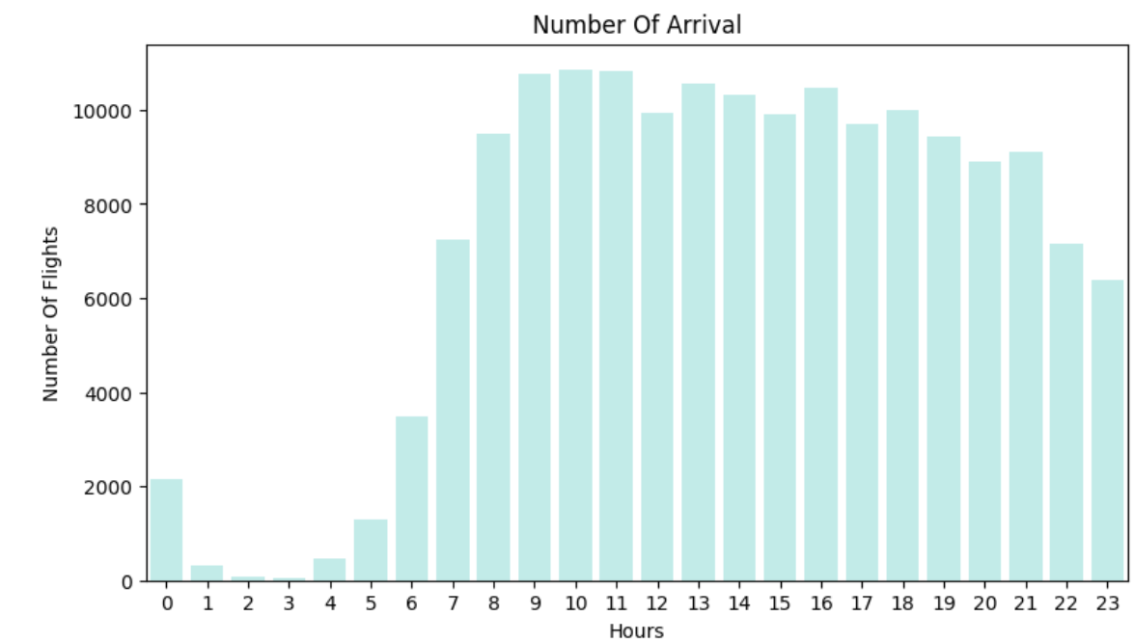

Slide 7
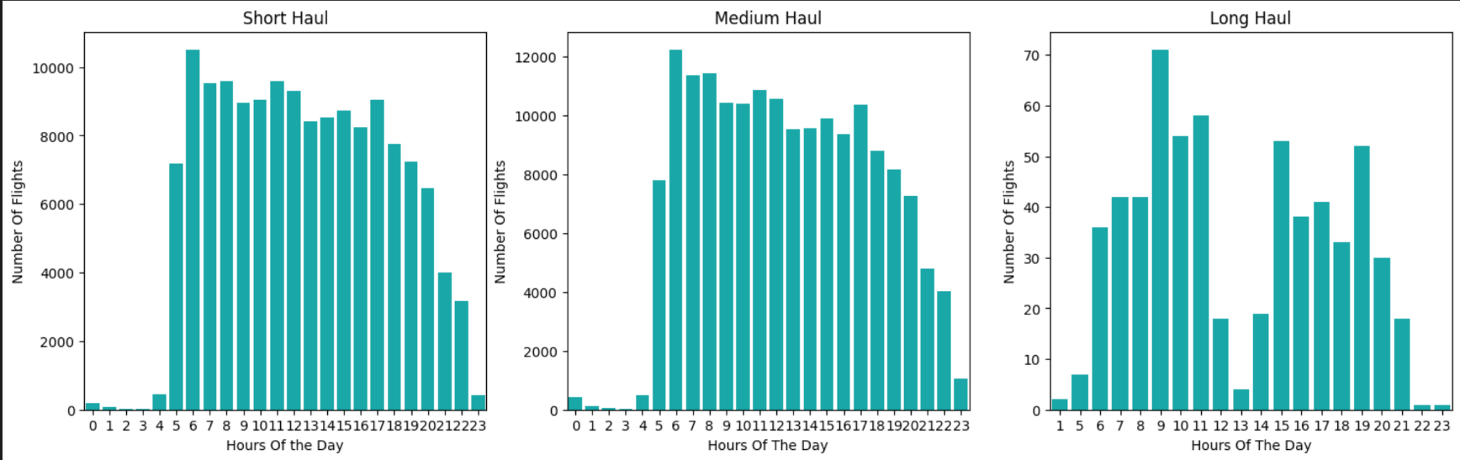
TAKE OFF TIME
Short haul - fly time between 30 mins to 3 hours
Medium haul - fly time between 3 hours to 6 hours
Long haul - fly time longer than 6 hours

Slide 8
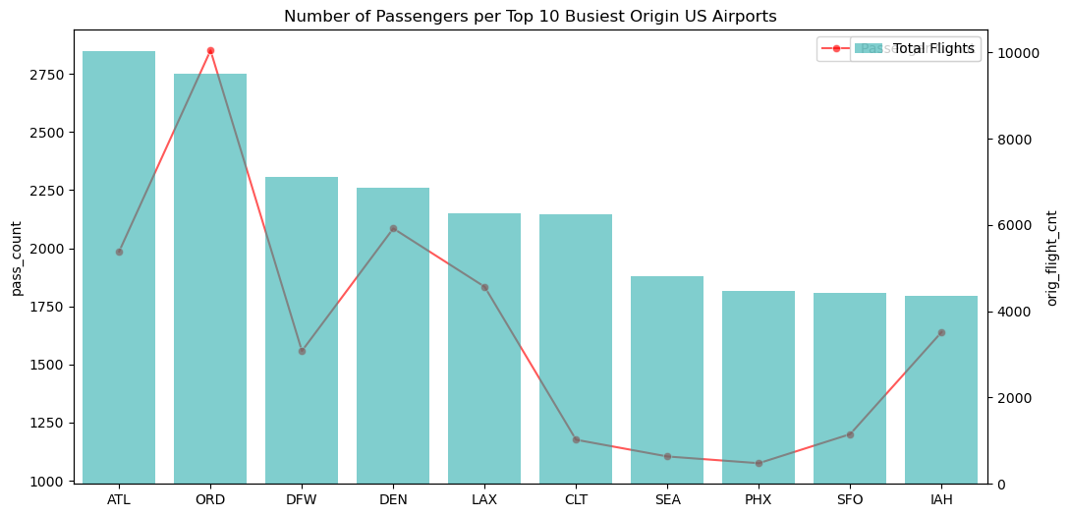

TOP 10 BUSIEST FLIGHTS IN ORIGIN & DESTINATION AIRPORTS (2018 & 2019)
In general, the top 10 busiest airports by the number of passengers account for both origin and destination flights.
For example, Atlanta, Orlando, Dallas.
Notes:
In general, the top 10 busiest airports are for both origin and destination flights. For example, Atlanta, Orlando, Dallas.

Slide 9
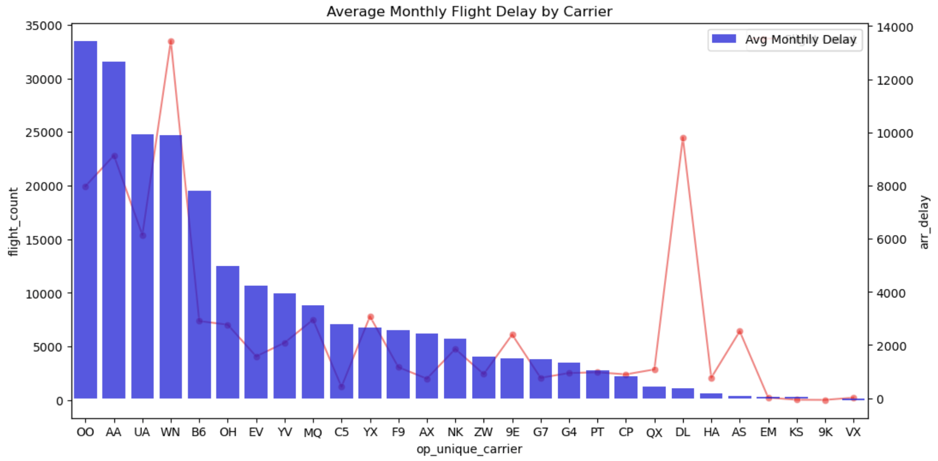
AVERAGE MONTHLY FLIGHT DELAY BY CARRIER
In general, there is an increase in average monthly arrival delays as flight count increases per air carrier. However, there is an outlier with Delta Airlines as it has low avg delay but high flight count.
Notes:
Generally, there is an increase in average monthly arrival delays as flight count increases per air carrier. However, there is an outlier with Delta Airlines as it has low avg delay but high flight count.

Slide 10
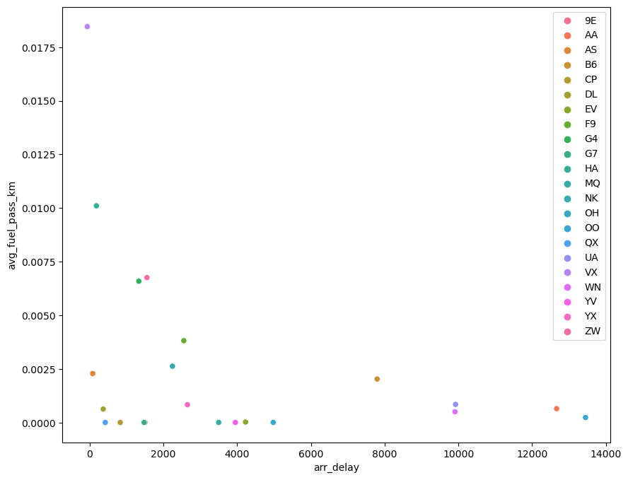
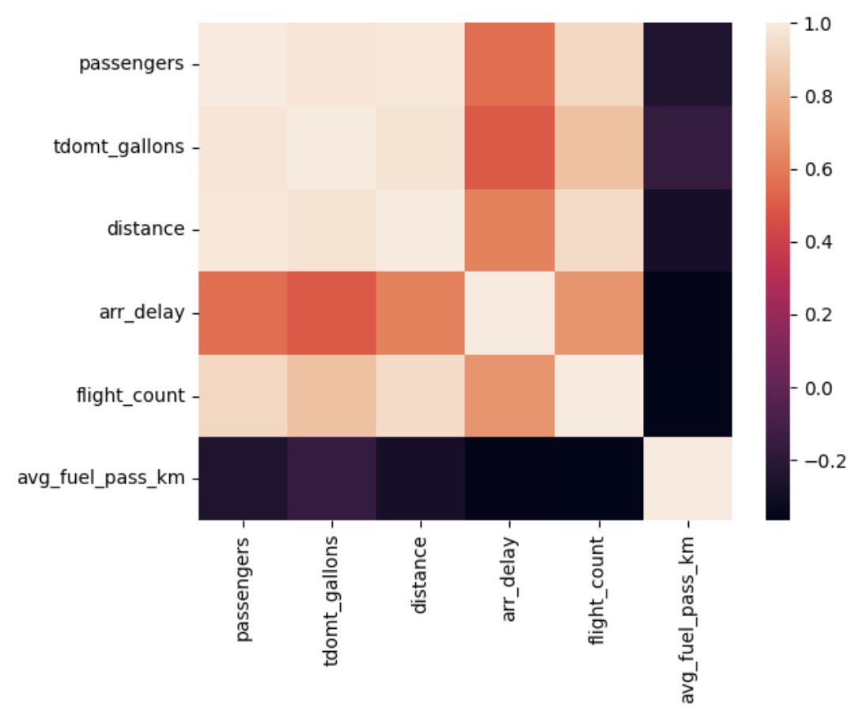
PASSENGERS AND FUEL CONSUMPTION (2015-2019)
Airline carriers United Airline (UA), Southwest Airline (WN), American Airline (AA) and Skywest (OO) have an average of over 8000 mins of arrival delay per month.
No correlation seen between average fuel consumption per passenger per km and bigger average delays.

Slide 11
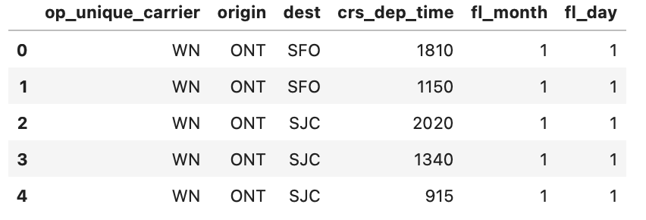
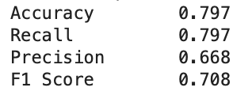
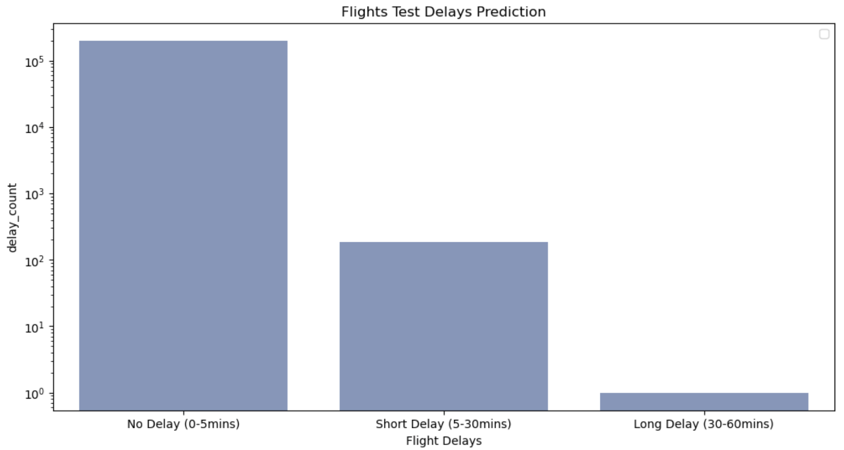
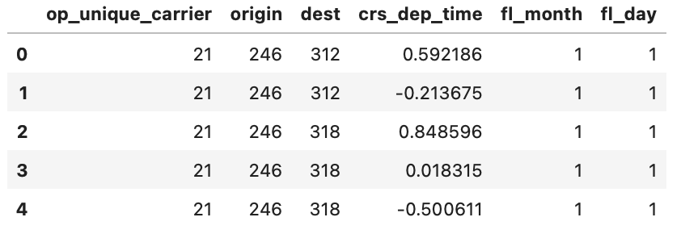
Modeling XGBoost
Selected Features
XGBoost
Flight Test Data Prediction
Label Encoding and Scaling
199811
188
1
Target Variable: delay_status
0: 0-5 mins arr_ delay
1: 5-30 mins arr_delay
2: 30-60 mins arr_delay
Notes:
Tried to break down the problem into a classification problem to improve accuracy.
Predicted Accuracy: 79%
Categorized arrival delays:
0: 0-5 mins delay
1: 5-30 mins delay
2: 30-60 mins delay

Slide 12
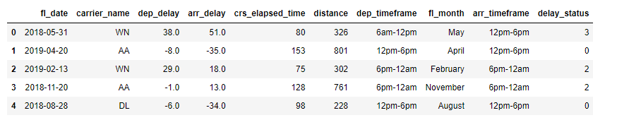
Feature Engineering
Categorized crs departure time and crs arrival time into time frames of 6 hours each.
Categorized the flight date into its respective month
Categorized arrival delay into delay status where
0 = no delay/early
1 = slight delay (<5mins)
2 = medium delay (5-30mins)
3 = long delay (over 30mins)

Slide 13


Modeling - RandomForestClassifier
Features used: carrier name, departure time frame, month of flight
Prediction of the exact delay:
Very low accuracy
Very low recall and precision values
Questionable reliability
Prediction the type of delay:
Better accuracy than predicting the exact arrival delay
Still not a reliable prediction

Slide 14

CHALLENGES
Weather
Limited calls for free API
Weather data was ambiguous (hard to classify weather condition)
Feature Engineering
Determining which features use for modelling (trial and error)
Modeling
Would require more time to try the different models and modify hyperparameters
Difficult to obtain a good prediction due to lack of numerical data
Arrival delay have high variance

Slide 15


